Slide 1

ExtRA: Extracting Prominent Review Aspects from Customer Feedback
Zhiyi Luo, Shanshan Huang, Frank F. Xu
Bill Yuchen Lin, Hanyuan Shi, Kenny Q. Zhu
Shanghai Jiao Tong University
09/12/2018

Slide 2
Problem
Extracting prominent review aspects from customer feedback
1
Notes:
As the title mentioned, this paper focus on the commonsense causal reasoning problem exists in short texts.
To solve this problem, it is essential to have the causality knowledge encodes in texts.
Our another goal is harvesting such causality knowledge, ensuring both coverage and precision.
Such causality knowledge is very useful for our causal reasoning problem, and it is also very helpful for
many other NLP applications, such as text understanding tasks.

Slide 3
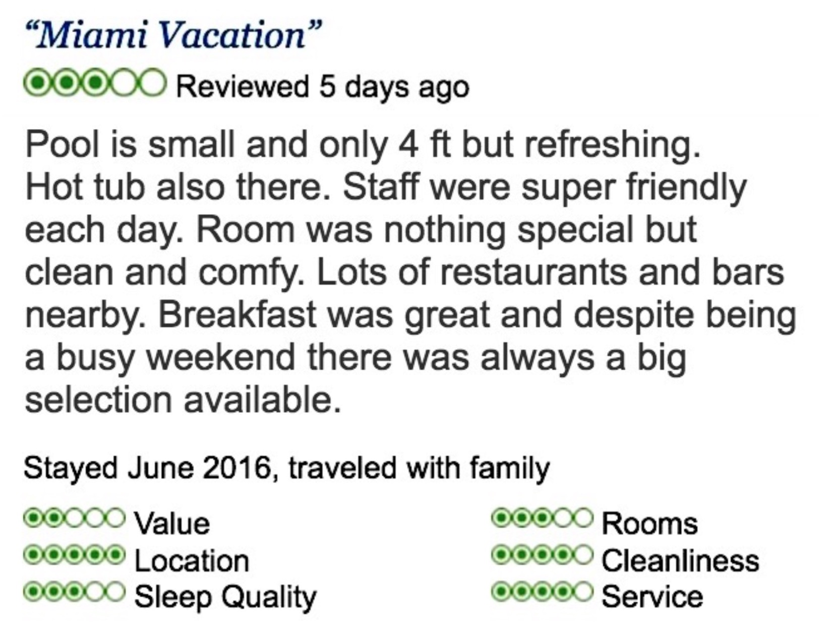
Problem
An example user review about a hotel from TripAdvisor
Extracting Prominent Review Aspects from Customer Feedback
Notes:
I will first describe the problem using an example user review about a hotel from TripAdvisor.

Slide 4
Problem
An example user review about a hotel from TripAdvisor
Extracting Prominent Review Aspects from Customer Feedback
Notes:
Given a product or service, in this case the product or service type is hotel,
The Prominent review aspects are the aspects that are most critical or be cared about by users
For example, for a hotel, people are care about its Value, Rooms, Location, cleanliness, sleep quality and service.
So the prominent aspects for a hotel are listed here.

Slide 5
Problem
An example user review about a hotel from TripAdvisor
Extracting Prominent Review Aspects from Customer Feedback
Notes:
People usually write down their feedback especially for the prominent aspects

Slide 6
Problem
More specifically, the problem is to generate most K prominent aspects of a given product type from textual reviews.
Example
Hotel, K=5
room, location, staff, breakfast, pool
Notes:
To formalize our problem a bit,
Our inputs are the text reviews about one type of product or service and the expect number of prominent aspects we want to extract.
And the output should be K prominent aspect terms extracted from the text reviews.
For example, we want to extract 5 most prominent aspects for the hotel service.
One reasonable output is: room, location, staff, breakfast, pool.

Slide 7
Framework
Aspect Candidates Extraction
Aspect Taxonomy Construction
Aspect Ranking
Aspect Generation
4

Slide 8
Framework
Aspect Candidates Extraction
Aspect Taxonomy Construction
Aspect Ranking
Aspect Generation
4

Slide 9

Aspect Candidates Extraction
Extraction Rules
Rule 1. If $amod(N, A)$, then extract $\left\langle N, A\right\rangle$.
Rule 2. If $nsubj(A, N)$, then extract $\left\langle N, A\right\rangle$.
Rule 3. If $\left\langle N, A_{i}\right\rangle$ and $conj(A_{i}, A_{j})$, then extract $\left\langle N, A_{j}\right\rangle$.
Notes:
We extract massive aspect candidates from the text reviews using following three rules

Slide 10

Aspect Candidates Extraction
Extraction Rules
Rule 1. If $amod(N, A)$, then extract $\left\langle N, A\right\rangle$.
Rule 2. If $nsubj(A, N)$, then extract $\left\langle N, A\right\rangle$.
Rule 3. If $\left\langle N, A_{i}\right\rangle$ and $conj(A_{i}, A_{j})$, then extract $\left\langle N, A_{j}\right\rangle$.
$N$ indicates a noun, and $A$ (e.g. $A_{i}$, $A_{j}$) is an adjective.
Notes:
We extract massive aspect candidates from the text reviews using following three rules

Slide 11

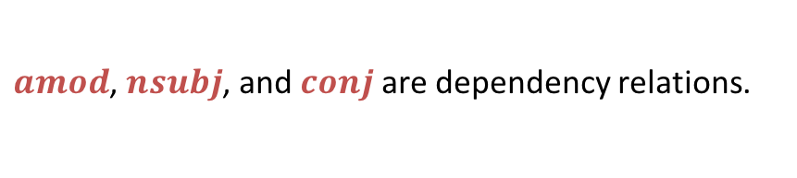
Aspect Candidates Extraction
Extraction Rules
Rule 1. If $amod(N, A)$, then extract $\left\langle N, A\right\rangle$.
Rule 2. If $nsubj(A, N)$, then extract $\left\langle N, A\right\rangle$.
Rule 3. If $\left\langle N, A_{i}\right\rangle$ and $conj(A_{i}, A_{j})$, then extract $\left\langle N, A_{j}\right\rangle$.
$amod$, $nsubj$, and $conj$are dependency relations.
Notes:
amod is the adjectival modifier dependency relation.
nsubj is the nominal subject relation.
conj is the conjunction relation.

Slide 12

Aspect Candidates Extraction
Extraction Rules
Rule 1. If $amod(N, A)$, then extract $\left\langle N, A\right\rangle$.
Rule 2. If $nsubj(A, N)$, then extract $\left\langle N, A\right\rangle$.
Rule 3. If $\left\langle N, A_{i}\right\rangle$ and $conj(A_{i}, A_{j})$, then extract $\left\langle N, A_{j}\right\rangle$.
$amod$, $nsubj$, and $conj$are dependency relations.
The
shutter
is really
slow
and
noisy.

Slide 13


Aspect Candidates Extraction
Extraction Rules
Rule 1. If $amod(N, A)$, then extract $\left\langle N, A\right\rangle$.
Rule 2. If $nsubj(A, N)$, then extract $\left\langle N, A\right\rangle$.
Rule 3. If $\left\langle N, A_{i}\right\rangle$ and $conj(A_{i}, A_{j})$, then extract $\left\langle N, A_{j}\right\rangle$.
$amod$, $nsubj$, and $conj$are dependency relations.
$$N$$
$$A_{i}$$
The
shutter
is really
slow
and
noisy.

Slide 14
Aspect Candidates Extraction
Extraction Rules
Rule 1. If $amod(N, A)$, then extract $\left\langle N, A\right\rangle$.
Rule 2. If $nsubj(A, N)$, then extract $\left\langle N, A\right\rangle$.
Rule 3. If $\left\langle N, A_{i}\right\rangle$ and $conj(A_{i}, A_{j})$, then extract $\left\langle N, A_{j}\right\rangle$.
$amod$, $nsubj$, and $conj$are dependency relations.
nsubj
$$N$$
$$A_{i}$$
The
shutter
is really
slow
and
noisy.

Slide 15

Aspect Candidates Extraction
Extraction Rules
Rule 1. If $amod(N, A)$, then extract $\left\langle N, A\right\rangle$.
Rule 2. If $nsubj(A, N)$, then extract $\left\langle N, A\right\rangle$.
Rule 3. If $\left\langle N, A_{i}\right\rangle$ and $conj(A_{i}, A_{j})$, then extract $\left\langle N, A_{j}\right\rangle$.
$amod$, $nsubj$, and $conj$are dependency relations.
opinion-aspect pairs
(slow, shutter)
nsubj
$$N$$
$$A_{i}$$
The
shutter
is really
slow
and
noisy.
Notes:
We extract the opinion-aspect pair (slow, shutter) from the sentence by applying Rule 2.

Slide 16

Aspect Candidates Extraction
Extraction Rules
Rule 1. If $amod(N, A)$, then extract $\left\langle N, A\right\rangle$.
Rule 2. If $nsubj(A, N)$, then extract $\left\langle N, A\right\rangle$.
Rule 3. If $\left\langle N, A_{i}\right\rangle$ and $conj(A_{i}, A_{j})$, then extract $\left\langle N, A_{j}\right\rangle$.
$amod$, $nsubj$, and $conj$are dependency relations.
opinion-aspect pairs
(slow, shutter)
nsubj
$$N$$
$$A_{i}$$
$$A_{j}$$
The
shutter
is really
slow
and
noisy.

Slide 17

Aspect Candidates Extraction
Extraction Rules
Rule 1. If $amod(N, A)$, then extract $\left\langle N, A\right\rangle$.
Rule 2. If $nsubj(A, N)$, then extract $\left\langle N, A\right\rangle$.
Rule 3. If $\left\langle N, A_{i}\right\rangle$ and $conj(A_{i}, A_{j})$, then extract $\left\langle N, A_{j}\right\rangle$.
$amod$, $nsubj$, and $conj$are dependency relations.
opinion-aspect pairs
(slow, shutter)
(noisy, shutter)
nsubj
conj
$$N$$
$$A_{i}$$
$$A_{j}$$
The
shutter
is really
slow
and
noisy.
Notes:
We further extract the pair (noisy, shutter) from the sentence by applying Rule 3.

Slide 18

Aspect Candidates Extraction
Extension Rules
Rule E1. If $\left\langle N, A\right\rangle$ and $N_{−1}_N∈P$, then use $\left\langle N_{−1}_N, A\right\rangle$ to replace $\left\langle N, A\right\rangle$.
Rule E2. If $\left\langle N, A\right\rangle$ and ${N_N}_{+1}∈P$, then use $\left\langle {N_N}_{+1}, A\right\rangle$ to replace $\left\langle N, A\right\rangle$.
Notes:
Note that many aspects are expressed by phrases, thus, we
extend the phrases as aspect candidates by introducing
the extension rules as follows:

Slide 19

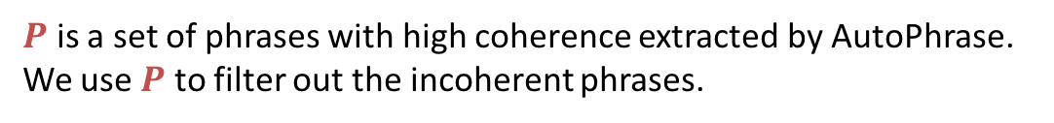
Aspect Candidates Extraction
Extension Rules
Rule E1. If $\left\langle N, A\right\rangle$ and $N_{−1}_N∈P$, then use $\left\langle N_{−1}_N, A\right\rangle$ to replace $\left\langle N, A\right\rangle$.
Rule E2. If $\left\langle N, A\right\rangle$ and ${N_N}_{+1}∈P$, then use $\left\langle {N_N}_{+1}, A\right\rangle$ to replace $\left\langle N, A\right\rangle$.
$P$ is a set of phrases with high coherence extracted by AutoPhrase.
We use $P$ to filter out the incoherent phrases.
Notes:
so as to obtain the high-quality phrases as aspect
candidates.

Slide 20

Aspect Candidates Extraction
Extension Rules
Rule E1. If $\left\langle N, A\right\rangle$ and $N_{−1}_N∈P$, then use $\left\langle N_{−1}_N, A\right\rangle$ to replace $\left\langle N, A\right\rangle$.
Rule E2. If $\left\langle N, A\right\rangle$ and ${N_N}_{+1}∈P$, then use $\left\langle {N_N}_{+1}, A\right\rangle$ to replace $\left\langle N, A\right\rangle$.
$P$ is a set of phrases with high coherence extracted by AutoPhrase.
We use $P$ to filter out the incoherent phrases.
.
It’s a
great
zoom
lens
Notes:
Here’s an example sentence: It’s a great zoom lens.

Slide 21



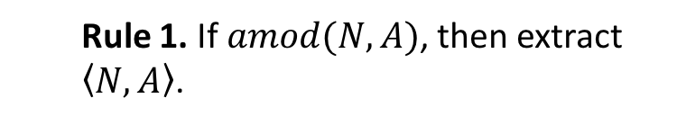
Aspect Candidates Extraction
Extension Rules
Rule E1. If $\left\langle N, A\right\rangle$ and $N_{−1}_N∈P$, then use $\left\langle N_{−1}_N, A\right\rangle$ to replace $\left\langle N, A\right\rangle$.
Rule E2. If $\left\langle N, A\right\rangle$ and ${N_N}_{+1}∈P$, then use $\left\langle {N_N}_{+1}, A\right\rangle$ to replace $\left\langle N, A\right\rangle$.
Rule 1. If $amod(N, A)$, then extract $\left\langle N, A\right\rangle$.
opinion-aspect pairs
(great, lens)
amod
$$A$$
$$N$$
.
It’s a
great
zoom
lens
Notes:
We identify the pair (great, lens) as the candidate.

Slide 22



Aspect Candidates Extraction
Extension Rules
Rule E1. If $\left\langle N, A\right\rangle$ and $N_{−1}_N∈P$, then use $\left\langle N_{−1}_N, A\right\rangle$ to replace $\left\langle N, A\right\rangle$.
Rule E2. If $\left\langle N, A\right\rangle$ and ${N_N}_{+1}∈P$, then use $\left\langle {N_N}_{+1}, A\right\rangle$ to replace $\left\langle N, A\right\rangle$.
Rule 1. If $amod(N, A)$, then extract $\left\langle N, A\right\rangle$.
opinion-aspect pairs
(great, lens)
(great, zoom lens)
amod
$$A$$
$$N_{−1}$$
$$N$$
.
It’s a
great
zoom
lens
zoom lens $∈P$
Notes:
We found that zoom lens is in P.
Then, we extract (great, zoom lens) as a valid pair instead of (great, lens).

Slide 23
Framework
Aspect Candidates Extraction
Aspect Taxonomy Construction
Aspect Ranking
Aspect Generation
4
Notes:
The aspect candidates extracted in the last stage come with the counts modified by adjectives.
We can directly use such raw counts to rank the aspect candidates.
This is one of the baseline models in our experiments.
However, such ranking usually suffers from the aspect overlapping problem which obviously violates the principle of pursuing both coverage and distinctiveness of prominent aspects.
In order to solve this problem, we construct an aspect taxonomy to obtain such overlapping information between aspect candidates by leveraging
the WordNet ontology.

Slide 24
Aspect Taxonomy Construction
WordNet Synset Matching
Aspect Taxonomy Extraction from WordNet
Notes:
In order to construct the aspect taxonomy by leveraging the wordnet
We first need to match the aspect candidate to the synset in wordnet
This is some kind of WSD (word sense disambiguation)

Slide 25
Aspect Taxonomy Construction
WordNet Synset Matching
a hinged blind for a window
a mechanical device on a camera
that opens and closes to control
the time of a photographic exposure.
Notes:
we aim to cluster the aspect candidates with similar semantics together.
Then, for each aspect candidate, we take the other candidates within the same cluster as its context for later disambiguation.

Slide 26
Aspect Taxonomy Construction
WordNet Synset Matching
most similar ?
shutter
shutter.n.01
context vector
synset vector
average
lens
lens_cover
zoom_lens
mechanical
device
…
camera
…
context
synset gloss
Notes:
we aim to cluster the aspect candidates with similar semantics together.
Then, for each aspect candidate, we take the other candidates within the same cluster as its context for later disambiguation.

Slide 27
Aspect Taxonomy Construction
Aspect Taxonomy Extraction from WordNet
shutter.n.01
shutter
Notes:
In order to construct the aspect taxonomy from WordNet, we first extract the hypernym paths for every matched synsets in the previous step.

Slide 28
Aspect Taxonomy Construction
Aspect Taxonomy Extraction from WordNet
shutter.n.01
Synset matching
shutter
Notes:
In order to construct the aspect taxonomy from WordNet, we first extract the hypernym paths for every matched synsets in the previous step.

Slide 29
Aspect Taxonomy Construction
Aspect Taxonomy Extraction from WordNet
entity.n.01
…
device.n.01
optical_device.n.01
shutter.n.01
Hypernym path
(Is-a relation)
shutter
Notes:
By definition, a hypernym path p of synset s is the is-a relation path from s to the root synset
(i.e. entity.n.01 for nouns).
We extract the hypernym paths for each matched synset si in the WordNet ontology
Aggregate all such paths to obtain the aspect taxonomy

Slide 30
Aspect Taxonomy Construction
Aspect Taxonomy Extraction from WordNet
Aspect Taxonomy
device.n.01
optical_device.n.01
lens.n.01
shutter.n.01
telephoto_lens.n.01
lens
shutter
zoom_lens

Slide 31
Aspect Taxonomy Construction
Aspect Taxonomy Extraction from WordNet
Notes:
After acquiring the aspect taxonomy for the given product or service, we can now tell if two aspects are semantically overlapped or not

Slide 32
Framework
Aspect Candidates Extraction
Aspect Taxonomy Construction
Aspect Ranking
Aspect Generation
4

Slide 33


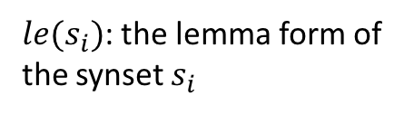
Aspect Ranking
Personalized Random Walk on Aspect Taxonomy
E: $x_{0}$
$le(s_{i})$: the lemma form of
the synset $s_{i}$
Notes:
Next, we propose a method based on personalized page rank
to compute the overall rank values for the potential aspects by leveraging the aspect taxonomy.

Slide 34

Aspect Ranking
Random Walk on Aspect Taxonomy
E: $x_{0}$
$le(s_{i})$: the lemma form of
the synset $s_{i}$
$f$: frequency function
lens
seeds
shutter
zoom_lens
Notes:
$f(le(s_{i}))$: the frequency that $le(s_{i})$ is modified by adjectives
There are seeds on which the initial scores distributed.

Slide 35
Aspect Ranking
Random Walk on Aspect Taxonomy
device.n.01
0.5
0.66
optical_device.n.01
0.32
lens.n.01
Teleport
shutter.n.01
0.75
telephoto_lens.n.01
lens
seeds
shutter
zoom_lens

Slide 36

Aspect Ranking
Random Walk on Aspect Taxonomy
E: $x_{0}$
$le(s_{i})$: the lemma form of
the synset $s_{i}$
$f$: frequency function
A: transition probabilities matrix
which are the normalized weights
on the edges of the taxonomy

Slide 37
Aspect Ranking
Random Walk on Aspect Taxonomy
E: $x_{0}$
$le(s_{i})$: the lemma form of
the synset $s_{i}$
$f$: frequency function
A: transition probabilities matrix
which are the normalized weights
on the edges of the taxonomy
Importance propagating

Slide 38

Aspect Ranking
Random Walk on Aspect Taxonomy
A: transition probabilities matrix
which are the normalized weights
on the edges of the taxonomy
device.n.01
0.5
0.66
optical_device.n.01
0.32
E: $x_{0}$
lens.n.01
Teleport
shutter.n.01
0.75
$α$: teleport factor
telephoto_lens.n.01
lens
Importance propagating
shutter
zoom_lens

Slide 39
Aspect Ranking
Random Walk on Aspect Taxonomy
Aspect Graph & Random Walk (Personalized Page Rank)
device.n.01
0.5
0.66
optical_device.n.01
0.32
lens.n.01
Teleport
shutter.n.01
0.75
telephoto_lens.n.01
lens
shutter
zoom_lens

Slide 40
Aspect Ranking
Random Walk on Aspect Taxonomy
A global ranking of nodes
aspect terms
scores
lens 0.025
telephoto_lens 0.012
shutter 0.009
…. ….

Slide 41
Framework
Aspect Candidates Extraction
Aspect Taxonomy Construction
Aspect Ranking
Aspect Generation
4

Slide 42
Aspect Generation
We generate the prominent aspects using the rank values of the aspects as well as the aspect taxonomy.
Top-K Aspects
Remove Taxonomy Overlapping
lens
telephoto_lens
shutter
….
Deduplication
Final Aspects
Notes:
In order to construct the aspect taxonomy from WordNet, we first extract the hypernym paths for every matched synsets in the previous step.

Slide 43
Evaluation
Dataset
WordNet Synset Matching
Comparisons for aspect extraction
1
Notes:
As the title mentioned, this paper focus on the commonsense causal reasoning problem exists in short texts.
To solve this problem, it is essential to have the causality knowledge encodes in texts.
Our another goal is harvesting such causality knowledge, ensuring both coverage and precision.
Such causality knowledge is very useful for our causal reasoning problem, and it is also very helpful for
many other NLP applications, such as text understanding tasks.

Slide 44
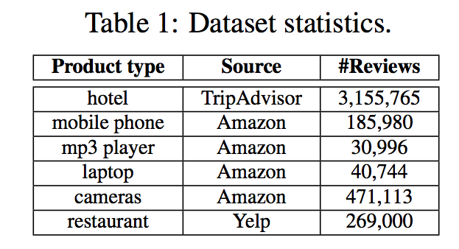
Dataset
Customer reviews corpora
Evaluation dataset
https://adapt.seiee.sjtu.edu.cn/extra/eval-dataset.txt

Slide 45
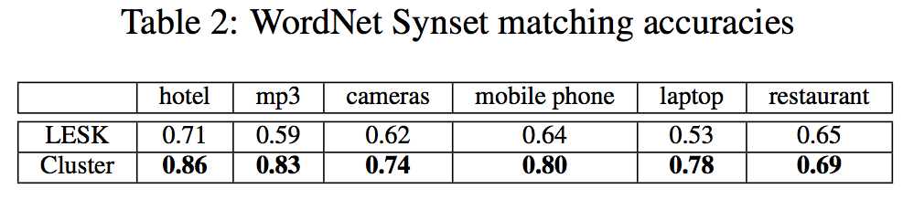
Evaluation: WordNet Synset Matching
LESK
Sample sentences with the aspect candidate and apply LESK algorithm on them.
Cluster

Slide 46
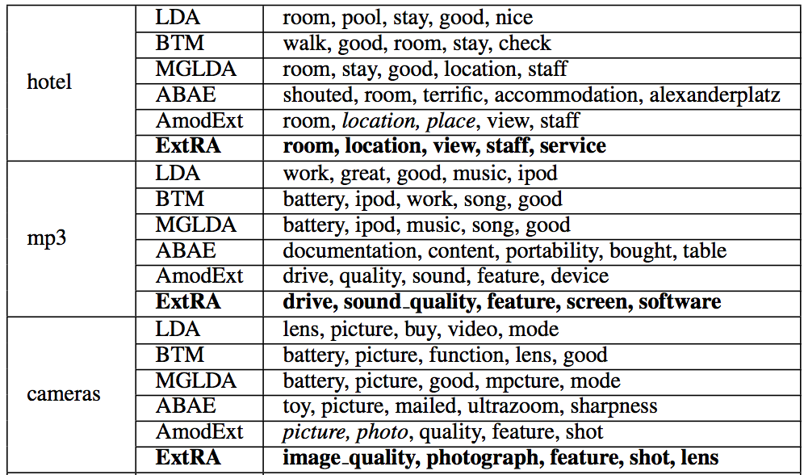
Comparisons for aspect extraction

Slide 47
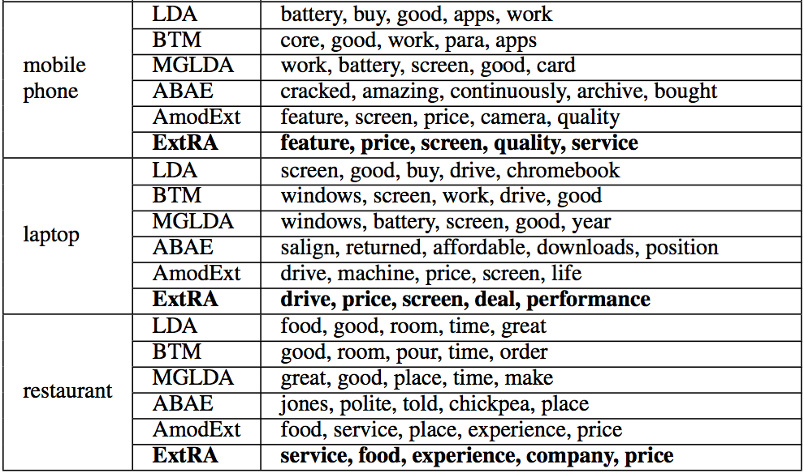
Comparisons for aspect extraction

Slide 48
Conclusion
We propose an unsupervised framework for extracting the most prominent aspect terms about a type of product or service from user reviews.
This would benefit both qualitative and quantitative aspect-based review summarization.
Using WordNet as a backbone, and by running personalized page rank on the extracted taxonomy, we can produce aspect terms that are both important and non-overlapping.

Slide 49
Q & A

Slide 50
End-to-End Evaluation: Comparisons for aspect extraction
Product / service | Prominent aspects
hotel | room, location, view, staff, service
mp3 | drive, sound_quality, feature, screen, software
cameras | image_quality, photograph, feature, shot, lens
mobile phone | feature, price, screen, quality, service
laptop | drive, price, screen, deal, performance
restaurant | service, food, experience, company, price

